Slide 1
Office Solutions Development
Topic 2:
An Introduction to End-User Software Development
Notes:
NCC Education - Title Master

Slide 2
Scope and Coverage
This topic will cover:
  The need to address both user and business requirements, including a discussion of the end-user’s role in developing application software and important features of interface design.
Notes:
NCC Education - Slide Master

Slide 3
Learning Outcomes - 1
By the end of this topic, students will be able to:
  Discuss the need for application software to meet user and business requirements
  Broadly define ‘end-user’ and ‘end-user development’
  List the range of software tools available for end-users to use when developing application software solutions.

Slide 4
Learning Outcomes - 2
  Identify the benefits and disadvantages of end-user development
  Discuss the need for analysis, design, testing and documentation
  Discuss the importance of efficient software interface design
  Identify end-user development guidelines
  Identify and discuss interface development in Microsoft Office

Slide 5
Terminology
  Terminology will be explained in the lecture, tutorial and laboratory session. You should take notes!
  A glossary of terms will be provided.
  Ask questions if you do not understand.

Slide 6
The Need for Application Software to Meet User and Business Requirements - 1
  Application software should be:
    Efficient in its functionality, for example, helping to solve problems, making decisions and improving system functions, such as automating regular processes, e.g. data entry
    User-friendly, e.g. easy to operate

Slide 7
The Need for Application Software to Meet User and Business Requirements - 2
  Application software should be (cont.):
    Reliable, e.g. producing the correct results of database query
    Secure, e.g. locking spreadsheet cells
    Maintainable, e.g. modification of a spreadsheet

Slide 8
End-User Application Software - 1
  In Topic 1, we discussed the two main types of software - commercial and bespoke.
  Application software can also be created and/or modified by an organisation’s own non-programming/technical staff. This development method is described as: end-user development (EUD).

Slide 9
End-User Application Software - 2
  End-user application software is developed by end-users (EUs) of computer systems to be used by them in their day-to-day work and is often also used by their colleagues in the same department and/or in other departments.
  Applications developed by end-users are also described as User Developed Applications (UDAs).

Slide 10
Software Tools Available for Developing Application Software Solutions
  Standard application software advanced functions in databases, spreadsheet and word processing
  Macros
  Visual Basic for Applications (VBA)
    Macros and VBA refer to application software programming methods and we will study how to use them in Topics 5–9.

Slide 11
Which Organisations Use EUD?
  Mainly, but not exclusively, small to medium enterprises (SMEs) for small scale development, e.g.
    Automating processes such as data entry and data output
    Information management and retrieval
    Facilitating data transfer between software applications, such as databases and spreadsheets
  Development can result from internal business processes, information systems and external business needs.

Slide 12





Business Processes that End-Users Develop
Accounting
and Finance
Web
Applications
EUD
Administration
Marketing

Slide 13





Accounting and Finance EUD
Budget
Analysis
Automate
data transfer
between
software
applications
Financial
Analysis
Accounting
And Finance
EUD
‘What If’
Analysis
Financial
Forecasting

Slide 14






Administration EUD
Database
Queries
Database
Reports
And Analysis
Data output
Administration
EUD
Data Entry
Automate
data transfer
between
software
applications

Slide 15






Marketing EUD
Database
Queries
Financial
Analysis
Database
Reports
And Analysis
Marketing
EUD
Data output
Automate
data transfer
between
software
applications
Data Entry

Slide 16
Benefits of EUD
  Greater user involvement
  User has knowledge of the functionality of the system
  Good use of resources
  Less costly method
  Improved decision making
  More user satisfaction

Slide 17
EUD Disadvantages
  Inaccurate (EU lacks training)
  Lack of planning
  Can be slow
  Use of incorrect formulae
  Not secure
  Not tested
  Not documented

Slide 18
Analysis, Design, Testing and Documenting Requirements - 1
  The user should concentrate on what needs to be done as well as how it should be done and plan carefully their software development:
    The task/problem should be analysed in detail and the user should understand clearly what needs to be done.
    The user and business requirements must be identified clearly.

Slide 19
Analysis, Design, Testing and Documenting Requirements - 2
    A solution must be designed that meets all requirements.
    The solution and results should be tested thoroughly.
    The solution should be documented.

Slide 20
Human Computer Interface Design
  Human Computer Interaction (HCI) refers to the interaction between users and the computer system that is enabled by using the hardware and software.
  Efficient HCI is necessary for usability of the system, e.g. the user should be able to interact with the system as simply and efficiently as possible.
  There are many aspects of HCI design, but we will concentrate on software interface design when developing our office solutions.

Slide 21
Software Interface Design
  Text (font type, font size, letter and line spacing, line length, justification, line endings, paragraph spacing)
  Colour (how it is used to draw attention, show meaning, etc.)
  Images (still and moving, how it is used to communicate, persuade, etc.)
  Sound (sound effects, music speech, how it is used to attract attention)

Slide 22
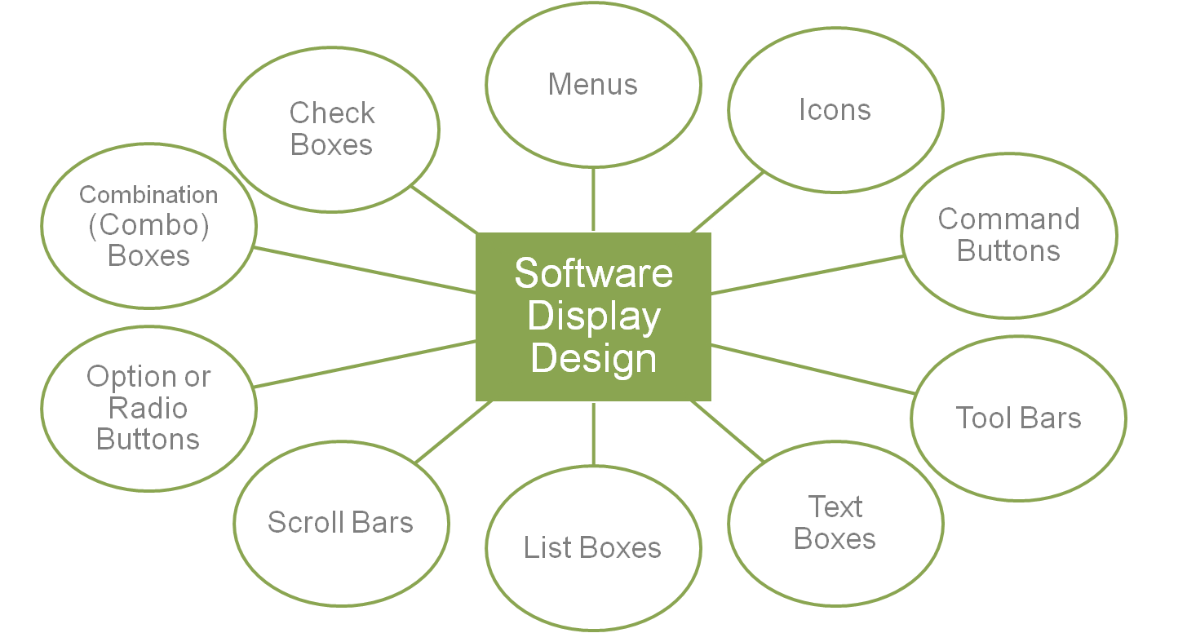
Software Display Design

Slide 23
EUD Guidelines
  EUs should be aware of and refer to the following guidelines when developing application software:
    ISO 9126 Software Quality Characteristics [Available Online] http://www.sqa.net/iso9126.html

Slide 24
Microsoft Office Suite Interface Development
  We will look at the development of the Microsoft Office Suite Interface (2003 – 2010) and discuss:
    changes in the interface layout
    new features
    updated features
    what impact these changes have on EUD

Slide 25
References
  ISO 9126 Software Quality Characteristics [Available Online]
  http://www.sqa.net/iso9126.html
  Office2010SuiteandVersionComparisonGuide.pdf (2010) [Available Online]
  Trulock, V. (2008), Understanding HCI, [Available Online]
  http://ilikecake.ie/hci/index.htm
  Usernomics, (2011), [Available Online]
  http://www.usernomics.com/

Slide 26
Topic 2 – An Introduction to End-User Software Development
Any Questions?
Notes:
NCC Education - End Slide Master

